Slide 1
Route 53
Osvaldo
03/07/2020

Slide 2
www.e-commerce...
S3
Publishing the website
EC2

Slide 3
1-
IPublic IP: 52.87.192.40
2-
Public DNS :ec2-52-87-192-40.compute-1.amazonaws.com
Publishing the website
S3
EC2
Not humanreadble
Amazon Route 53

Slide 4
What does Route 53 do?
my website server
or content in
Value
(Target) Type
Buy and
Registar a Domain
Create Domain Variations
via Sub Domains
Maping
Value (Target)
Record Type
awsdevopsteam.net
xxxx.awsdevopsteam.net
A
AAA
IP of Server
2.3.4.5
(naked domain)
yyy.awsdevopsteam.net
zzz.awsdevopsteam.net
End point
Point out
S3 Bucket url
Load Blancer
Domain Name
CNAME
Alias
Mail Server hostnane
MX
Value type determines the record type
Etc..

Slide 5
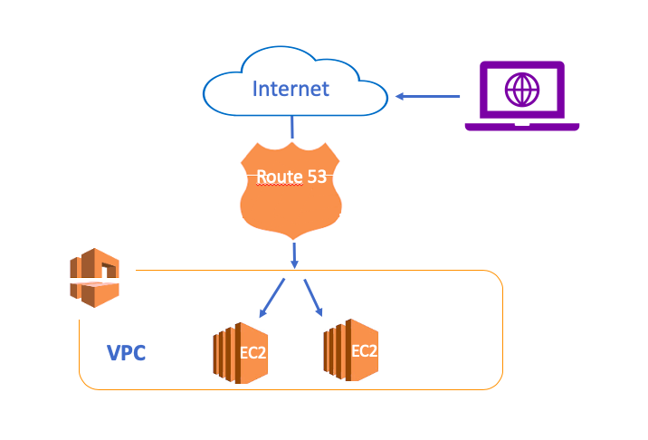

A record
CNAME
Alias
Hosted Zone is a component
where you locate the records
=
Database of the Route 53

Slide 6

A record =IP
1
2
A Record-1
A Record-2
help.osvaldo.com
www.osvaldo.com
A Record-1
server
IP:1.2.3.4
3
Server-1
IP:5.6.7.8
IP
A Record-1
www.osvaldo.com
A Record-3
IP:1.2.3.4
A Record-2
Server-2
Domanin
Name
IP:5.6.7.8

Slide 7
CNAME: DNS-URL
S3 bucket endpoint: http://www.awsdevopsteam.net.s3-website-us-east-1.amazonaws.com
Website domain: www.awsdevopsteam.net
A record -Primary
A record -Primary
www.awsdevopsteam.net= 1.2.3.4
21.22.23.3.4
11.12.13.14
local.awsdevopsteam.net = 1.2.3.4
7.8.9.10
11.12.13.14
info.awsdevopsteam.net= 1.2.3.4
7.8.9.10
11.12.13.14
mobile.awsdevopsteam.net= 1.2.3.4
7.8.9.10
11.12.13.14
mail.
www.awsdevopsteam.net= 1.2.3.4
7.8.9.10
11.12.13.14
local.awsdevopsteam.net = www.awsdevopsteam.net
info.awsdevopsteam.net = www.awsdevopsteam.net
mobile.awsdevopsteam.net = www.awsdevopsteam.net
A record -2
3 Cname
CNAME = Refer the domain
A record -3
A record -4

Slide 8
CNAME: DNS-URL
S3 bucket endpoint: http://www.awsdevopsteam.net.s3-website-us-east-1.amazonaws.com
Website domain: www.awsdevopsteam.net
Jonny
Honey
Sociall Security Number
BA1112345678-235
Jonathan
Daddy

Slide 9
Alias: DNS-URL
in AWS
Load balancer endpoint: dualstack.load2-2068187317.eu-west-1.elb.amazonaws.com
S3 bucket endpoint: http://www.awsdevopsteam.net.s3-website-us-east-1.amazonaws.com
Naked domain: awsdevopsteam.net
A record
Alias
CNAME
1- Alias is like an extension of the other record
It is not a standalone record
Alias
TXT
Alias
MX
Alias
2- Best practice:
Alias is used for AWS resources
Cname is used for domains

Slide 10
Mapping Domain name to the Static web site from S3 bucket
Cheaper
Alias
More Expensive
CNAME
Create A record
Create CNAME record
Choose Alias
Choose Bucket
Write Bucket Name

Slide 11
Sub Domain
Refers to
IP
A Record
Sub
Domain
Refers to
CNAME
Refers to
AWS Resource
Alias
www. clarusway.com

Slide 12

Failover
www.osvaldo.com
Primary
Secondary
www.osvaldo
www.osvaldo
IP:1.2.3.4
IP:1.2.3.4
S3 url
server
Server-2
Health Check
IP:1.2.3.4
IP:3.4.5.6
Static webHosting

Slide 13

Failover
Secondary
or
6
1
http://www...
S3
2
7
Primary
EC2
http://www
5
3
4
B
Unhealthy
Healthy
http://www
Health Check
A

Slide 14
Geolocation
x
others
3
2
1
1- Country
2- Continent
3- Default
It depends on where the user is
User

Slide 15
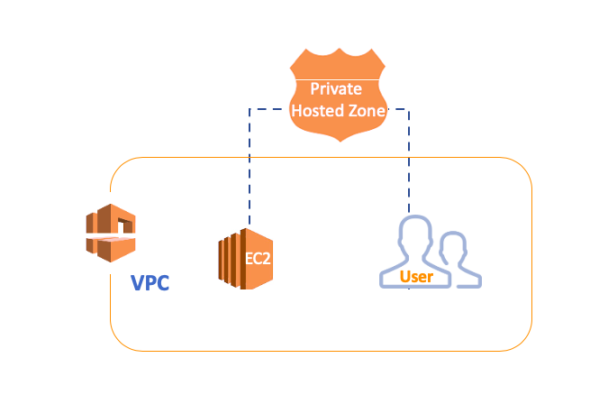
Domain in Route 53
Private Hosted zone Name
Domain Variations
Public Hosted Zone Name
Domain Variations
awsdevopsteam.com
….awsdevopsteam.com
awsdevopsteam.net
xxxx.awsdevopsteam.net
or
google.com
…..google.com
yyy.awsdevopsteam.net
or
whateveryouwant.com
..whateveryouwant.com

Slide 16

in VPC
Public
Local
Windows Instance
Public
server
Local
server
www. awsdevopsteam.net
www. awsdevopsteam.net

